Slide 1
Hands-on with Power Apps and Azure

Slide 2
Session Objectives
At the end of this session, you should be better able to…
Build a Power Apps and Azure solution
Demonstrate the advantages to use Power Apps to deliver a POC rapidly

Slide 3
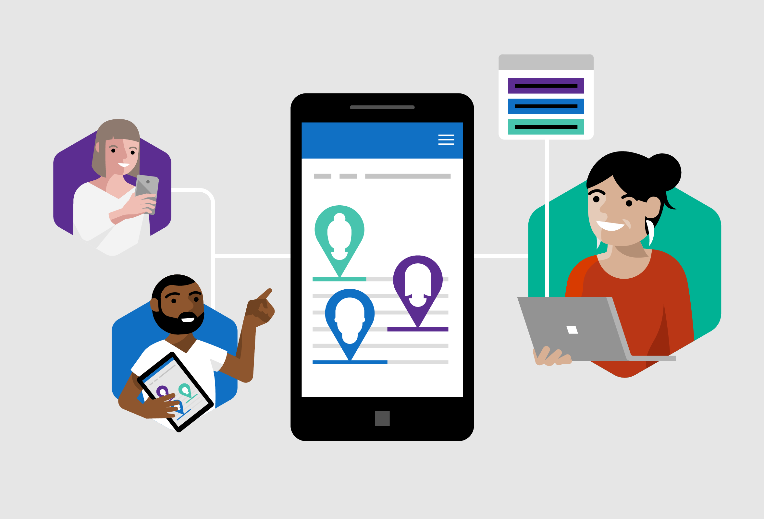
Empower every developer to do more.
Power Apps Mission
Citizen Developers.
IT Developers.
Pro Developers.
Notes:
As we kick off, I wanted to mention the overall mission of Power Apps. Our goal is to empower every developer to do more.
It is pretty simple.
It means that we want to make it so citizen developers – that is, truck drivers, security guards, dispatchers, accountants and more – to be able to solve their own problems.
It also means that we want to make IT and Pro Developers, that can write code, more productive and more efficient.
Every developer – even if you do not know it yet – are welcome to Power Apps.

Slide 4
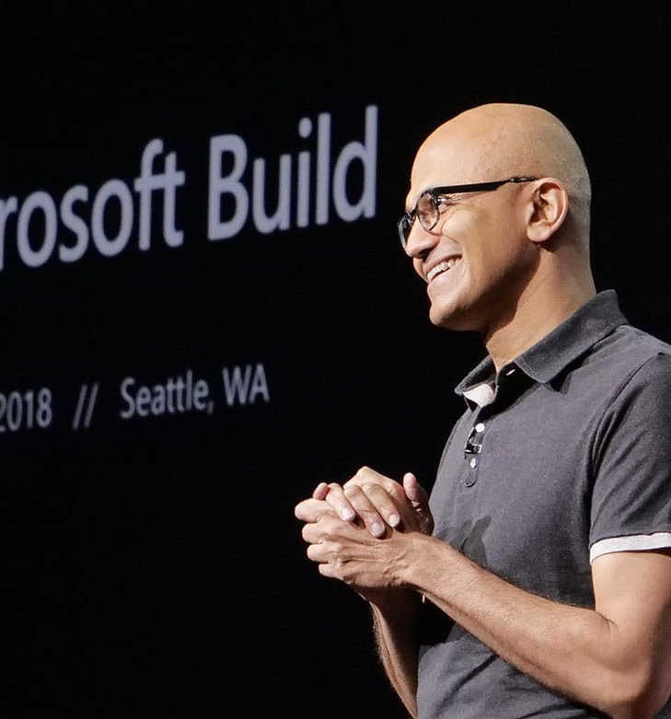

“Microsoft 365, Dynamics 365, and the Power Platform, on top of what we’re doing with Azure, is the core of what we are doing as a company.”
--Satya Nadella, January 2019

Slide 5

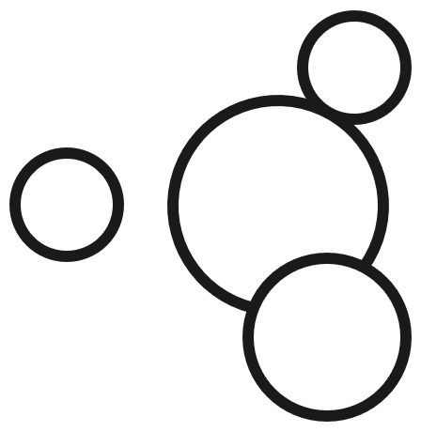
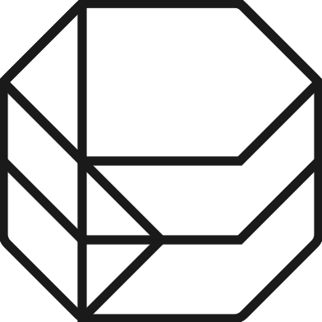
Microsoft Power Platform
The low-code platform that spans Office 365, Azure, Dynamics 365, and standalone applications
Power BI
Business analytics
Power Apps
Application development
Power Automate
Process automation
Power Virtual Agents
Intelligent virtual agents
Data connectors
Common Data Service
AI Builder
Notes:
The Microsoft Power Platform – Empowering millions of people to achieve more
Our vision for the Power Platform started from the recognition that data is increasingly flowing from everything, and a belief that organizations that harness their data – to gain insights then used to drive intelligent business processes – will outperform those that don’t.
We also recognize there aren’t enough programmers, data scientists and tech professionals to go around. So our goal was to build a platform targeting these technology experts and the millions of other frontline workers who see opportunities every day to create something better than the status quo, but who’ve never been empowered to do anything about it.
The Common Data Service, Data Connectors, and new AI Builder also are common building blocks across the Power Platform.

Slide 6

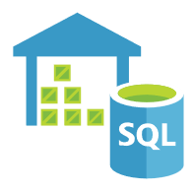

Develop faster than ever before
Azure + Power Apps = No Limits
Power Platform
Every Developer
Power Apps
Azure
DevOps
Azure services
API management
Azure Functions
AKS
Cognitive Services
Pro Developer
Azure Data Services
Cosmos DB
SQL Azure
SQL Data Warehouse
Visual
Studio
VS
Code
Notes:
Power Apps is all about being fast, and moving quickly, to develop your applications.
What is great is that you will never hit limits with Power Apps. That is because Power Apps has great connectivity into Azure – for compute or API services, like Azure Functions, API Management, or Azure Kubernetes Service. It also can connect to all the Azure data services, like Azure SQL, Cosmos DB, or SQL Data Warehouse.
On top of that – all the standard dev tools work. You can use Visual Studio to write plugins. You can write VS Code to write custom controls. And you can use Azure DevOps to deploy.
In the end – there are no limits to what you can do with Power Apps.

Slide 7
Introduction to the Hands-on Lab

Slide 8
Accessing Enterprise API endpoints with Power Apps
Purpose
To demonstrate how Power Apps can help unlock the potential of untapped assets within an Enterprise ( legacy APIs & data sources) with a low-code / no code approach
Expected time to complete
Around 45 mins
Implementation
Azure API App as the middle tier (exemplifying a connection to several enterprise APIs)
Canvas app front-end using Custom Connector (rapidly iterative app-development)

Slide 9
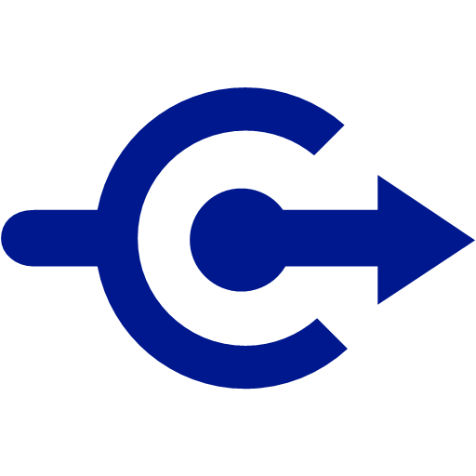
Components of the Lab
Custom Connector
Power Apps
(Imaginary – not actually part of the lab)
Front line Worker with devices
Inventory Data from SAP

Slide 10
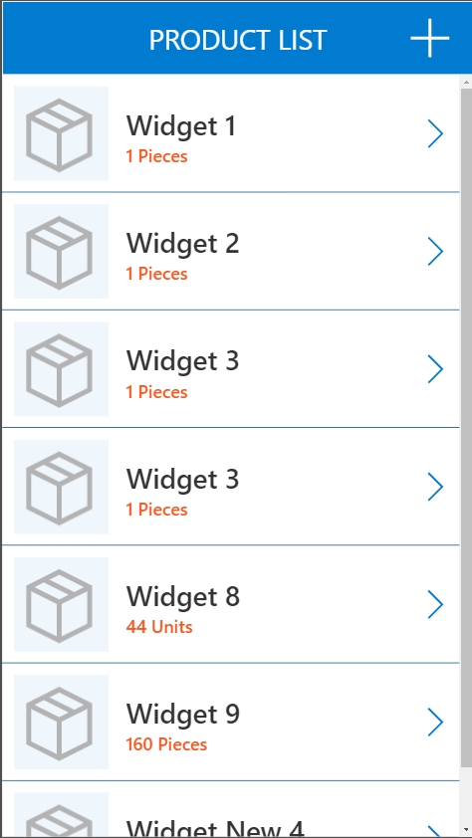
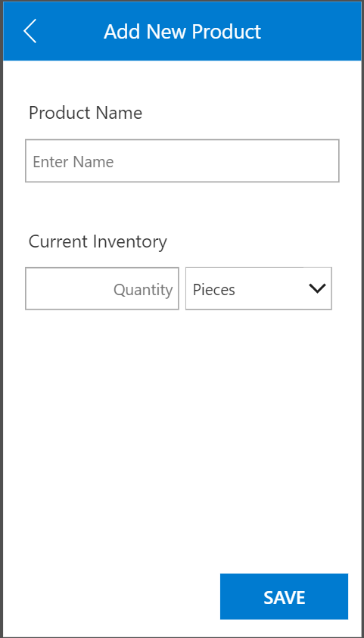
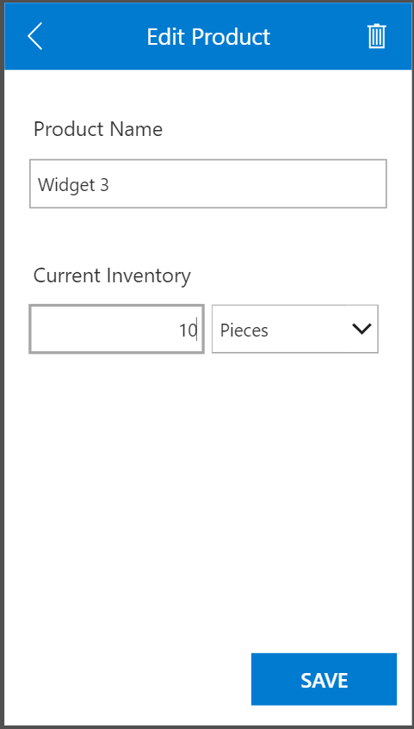
Lab outcome Simple Power Apps Canvas App to Create, Read, Update & Delete (CRUD) Product Items

Slide 11
Lab instructions and time estimates
Lab introduction (10 minutes)
Deploy API App and test (15 minutes)
Deploy API app in your own subscription
Create custom connector
Create a PowerApp Canvas app (30 minutes)
Create list screen
Create Edit / Add screen
Wire up the navigation and logic
Q & A (5 minutes)

Slide 12
Lab Manual : https://aka.ms/PowerAppsAzureLab

Slide 13
Session takeaways
Power Apps can provide a rapid cross-platform UX to consume a lot of Azure services
Power Apps can help accelerate large cloud migrations by providing an interim Hybrid layer
Call to Action:
Use the skills acquired to imagine new customer demos/POCs
Have a conversation with your customers to drive adoption of Power Platform
Notes:
This slide is required. Do NOT delete. This slide is required just prior to the “session resources” slide
SESSION TAKEAWAYS & ACTIONS: Bullet points highlighting the primary actions learners should take away or knowledge learners should recall to help them successfully perform in role (e.g. practical guidance, tips, suggested behavior changes.)
Please Note: Session Takeaways are not required for Group Discussions; however, takeaways should be captured real time by the facilitator during the session and those key points should be emphasized during the discussion or workshop. If you have questions, please contact your Track Content Lead.

Slide 14
Resources
App in a Day: https://aka.ms/AppInADay
Power Apps Learning Resources: https://aka.ms/PowerApps-Resources
Microsoft Learning Path : https://aka.ms/PowerUp

